Slide 1
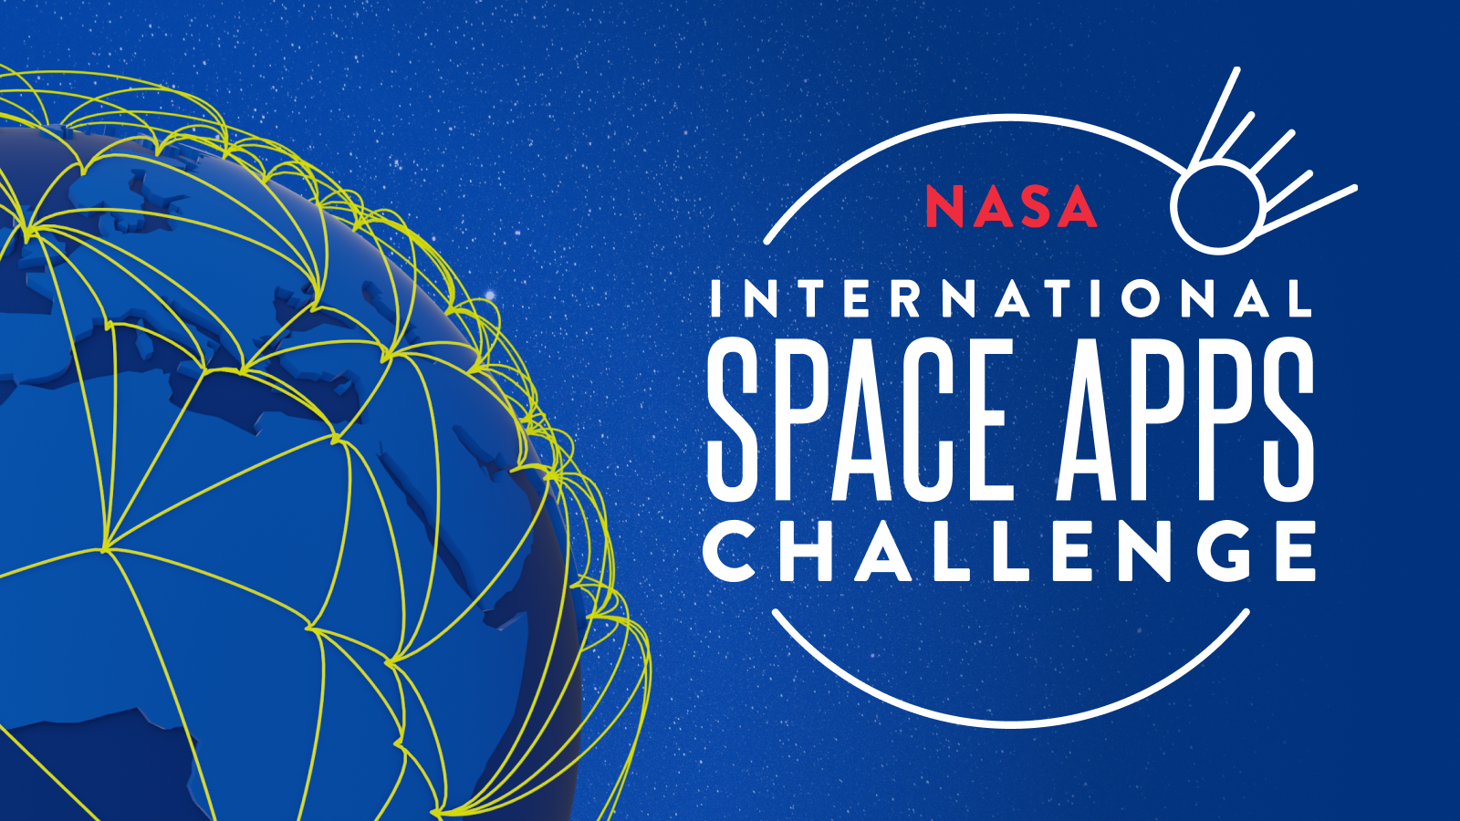

Slide 2


EXASCALE OPEN DATA ANALYTICS LAB
NATIONAL CENTER IN BIG DATA AND CLOUD COMPUTING (NCBC)
/ExascaleLabNED

Slide 3
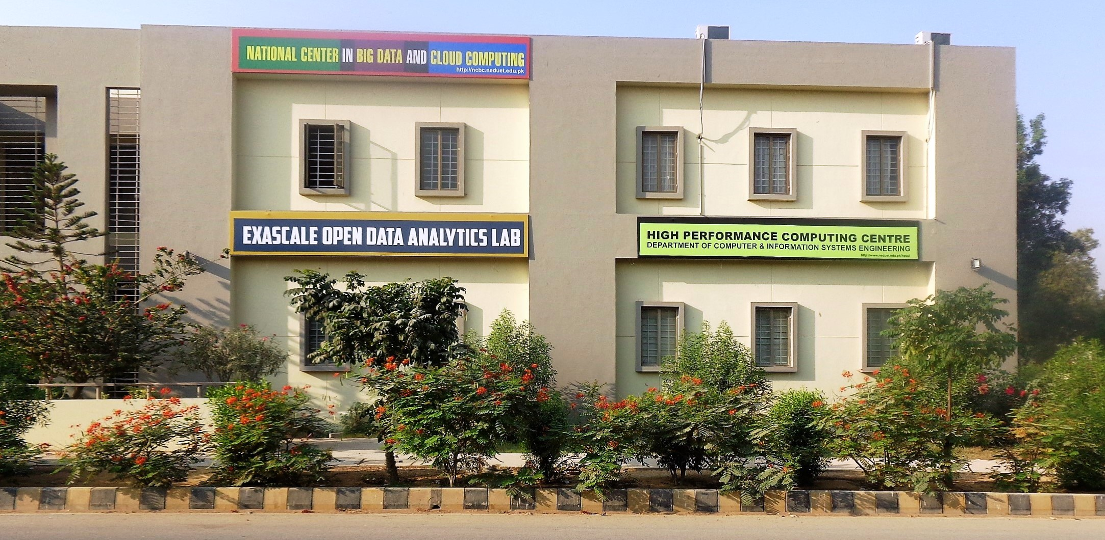

Slide 4
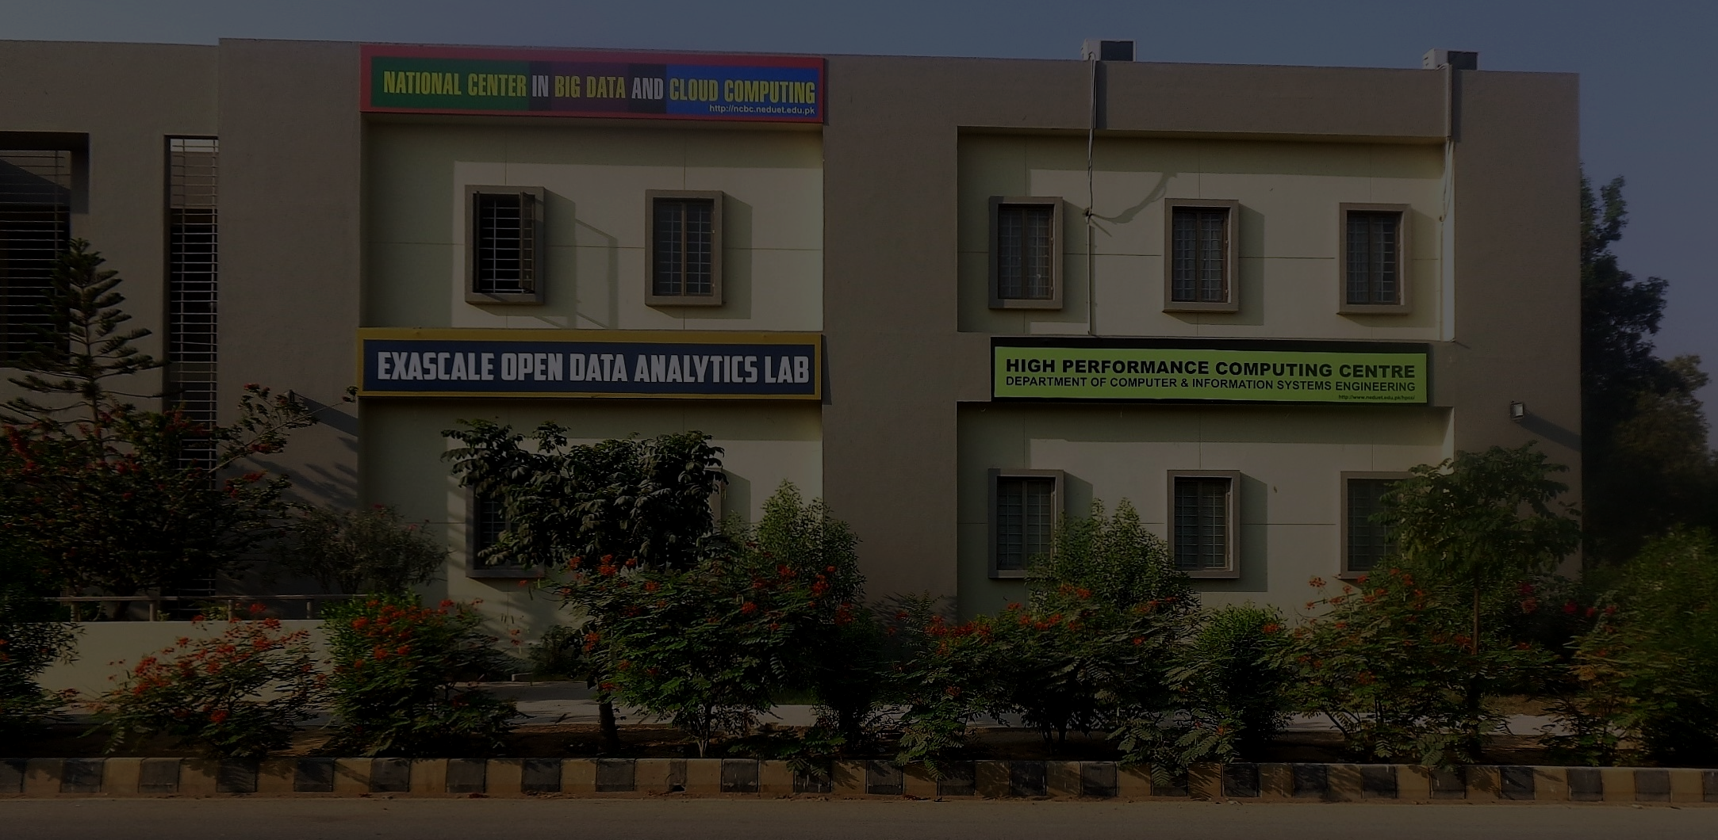
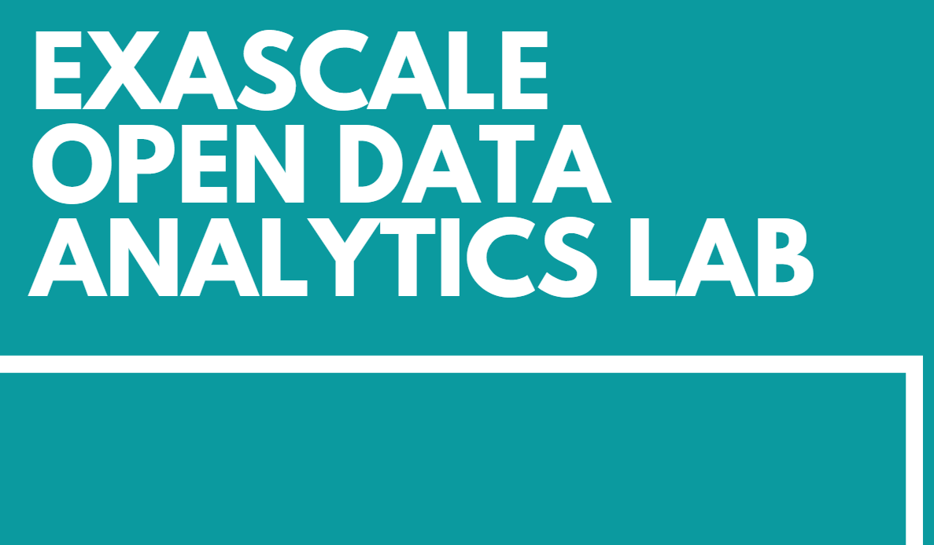
Exascale OpenLab is a unique partnership concept which will provide framework through which NEDUET can collaborate with leading ICT companies to accelerate the development and deployment of the cutting edge ICT solutions related to big data and its analytics on cloud using Open source platforms.
Computational Astrophysics & Space Science
Tsunami Modeling
Genomics
Traffic Pattern Analysis

Slide 5
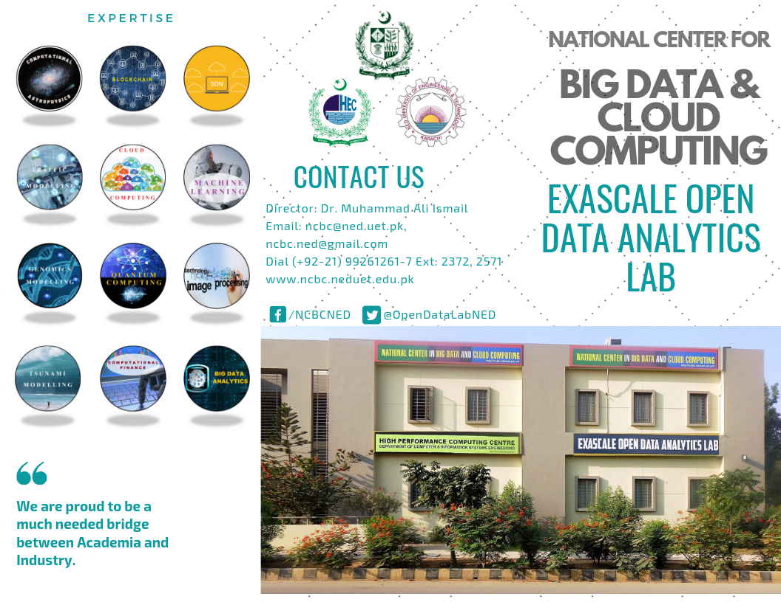
Brochure

Slide 6
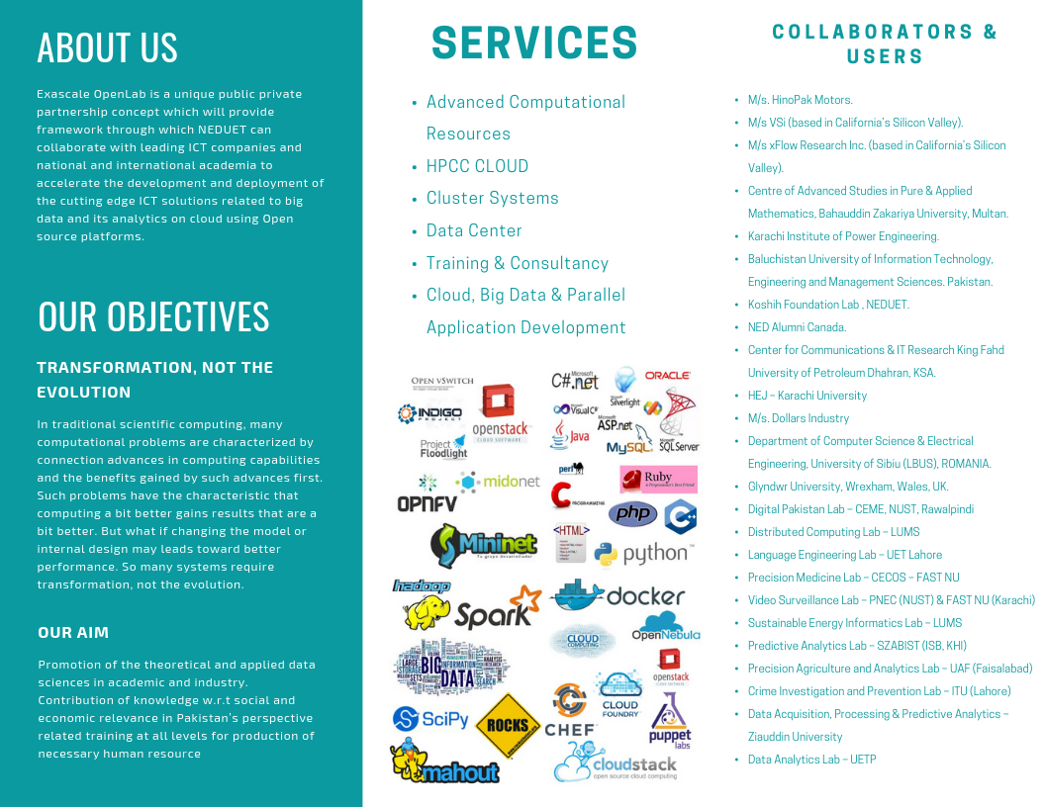
Brochure

Slide 7
OBJECTIVE
The objective is to develop an AI application to improve the accessibility and discoverability of records in the NASA Technical Reports Server (NTRS).
Using Natural Language Processing (NLP) to automatically read NASA Technical Reports Server (NTRS) summarize them, generate text analytic data, and produce a list of topic keywords to help researchers find the documents they need.

Slide 8
GOAL
NTRS includes hundreds of thousands of items containing scientific and technical information (STI) this project is to assist researchers in accessing NTRS documents using Artificial Intelligence(AI).
Web Application is developed to help researchers to give NTRS database pdf file as input making it easier for them to see the summary of the relevant NTRS record with some visualizations and keywords of the topics discussed in the pdf.
Web App is developed using Python web framework flask that uses deep learning model to summarize and carry out insights of the document integrated with a user interface.

Slide 9
OUTCOME
Extraction of text from PDF files.
Summarization of the text.
List of top Keywords present in the text.
Word cloud generation i.e (visualization of top frequent words).
Top 10 most often used word count graph.

Slide 10
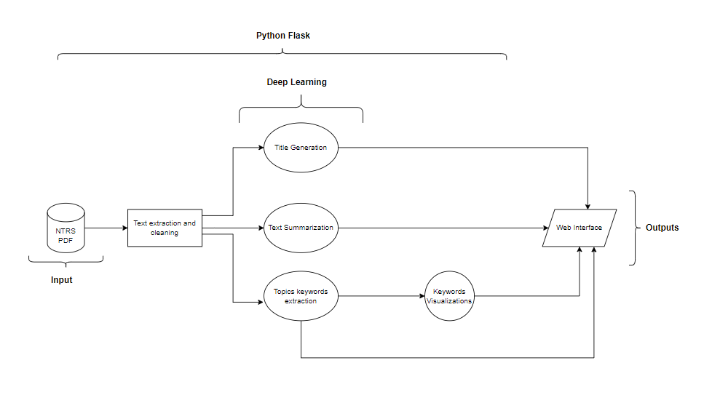
FLOW DIAGRAM

Slide 11
LIVE DEMO
http://localhost:5000/

